Slide 1
CSE 417T Introduction to Machine Learning
Lecture 8 Instructor: Chien-Ju (CJ) Ho

Slide 2
Logistics
HW1: Due Feb 14
Reserve time if you have never used Gradescope
Make sure the submission is readable (if you scan your handwriting)
Correctly assign pages to each problem
HW2: Due Feb 24
Exams
Exam1: March 10 (Thursday)
Timed exam at the lecture time
More logistical details to come within 1~2 weeks
Exam 2: last lecture of the semester

Slide 3
Recap

Slide 4
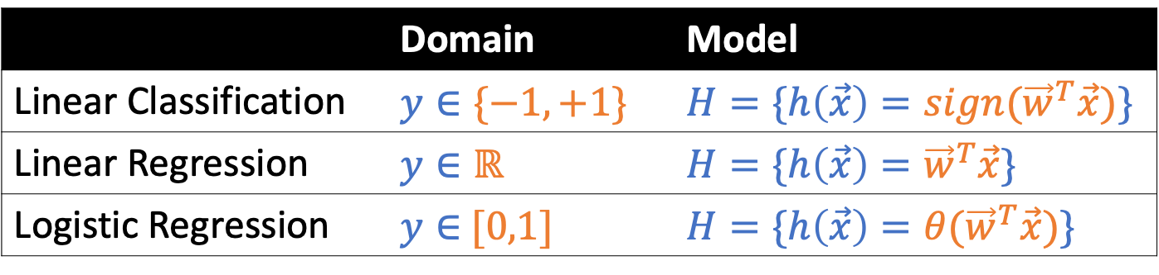
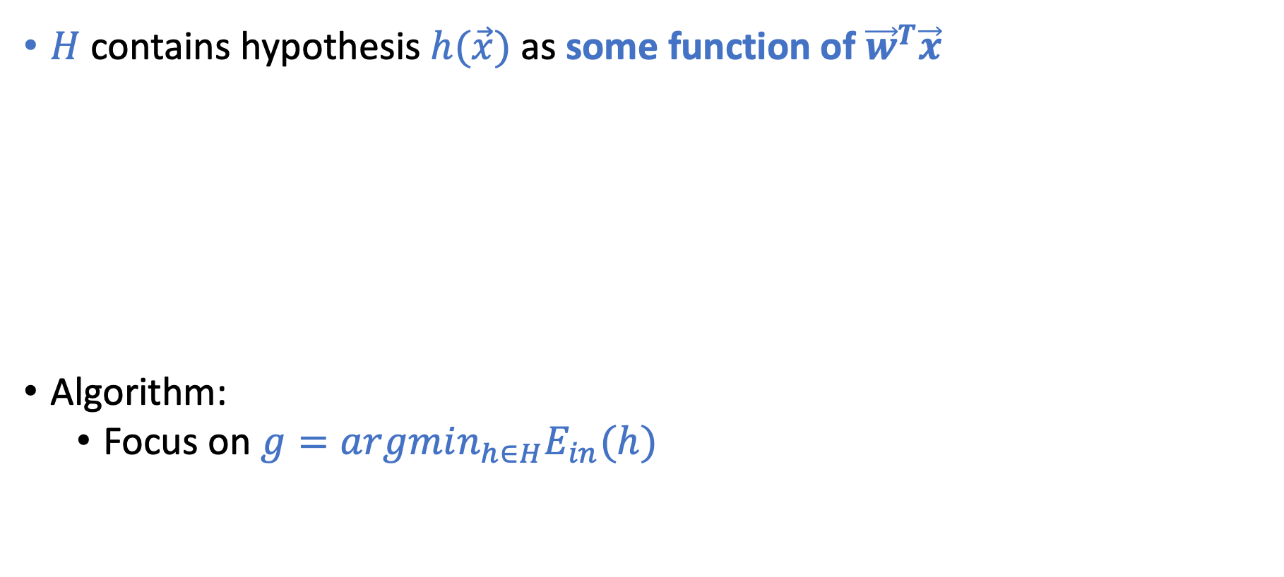
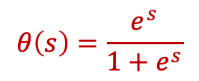
Linear Models
This is why it’s called linear models
$H$ contains hypothesis $h(\vec{x})$ as some function of ${\vec{w}}^{T}\vec{x}$
Algorithm:
Focus on $g=argmin_{h∈H}E_{in}(h)$
 | Domain | Model
Linear Classification | $$y∈\{−1,+1\}$$ | $$H=\{h\left(\vec{x}\right)={sign(\vec{w}}^{T}\vec{x})\}$$
Linear Regression | $$y∈ℝ$$ | $$H=\{h\left(\vec{x}\right)={\vec{w}}^{T}\vec{x}\}$$
Logistic Regression | $y∈$ $[0,1]$ | $$H=\{h\left(\vec{x}\right)={θ(\vec{w}}^{T}\vec{x})\}$$
Credit Card Example
Approve or not
Credit line
Prob. of default
$$θ\left(s\right)=\frac{e^{s}}{1+e^{s}}$$

Slide 5

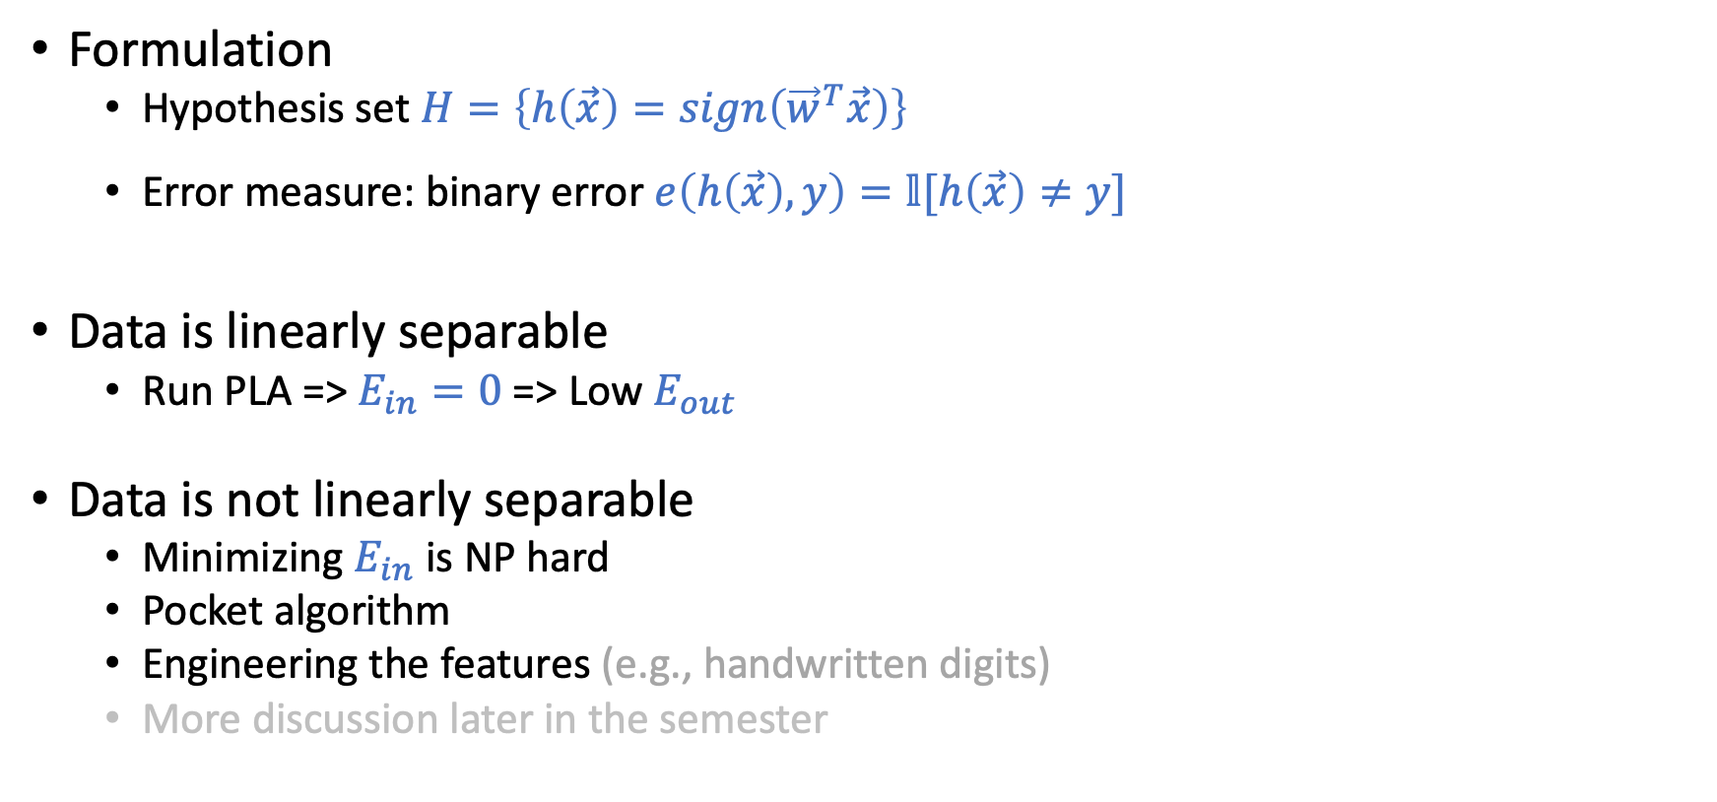
Linear Classification (Perceptron)
Formulation
Hypothesis set $H=\left\{h\left(\vec{x}\right)=sign\left({\vec{w}}^{T}\vec{x}\right)\right\}$
Error measure: binary error $e\left(h\left(\vec{x}\right),y\right)=𝕝[h\left(\vec{x}\right)≠y]$
Data is linearly separable
Run PLA => $E_{in}=0$ => Low $E_{out}$
Data is not linearly separable
Minimizing $E_{in}$ is NP hard
Pocket algorithm
Engineering the features (e.g., handwritten digits)
More discussion later in the semester

Slide 6
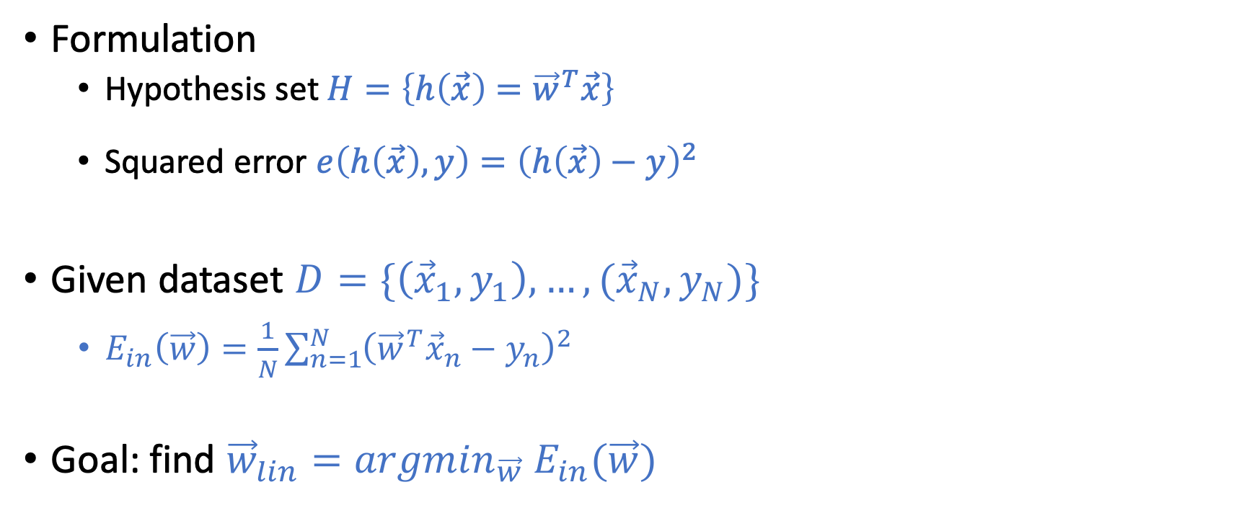
Linear Regression
Formulation
Hypothesis set $H=\left\{h\left(\vec{x}\right)={\vec{w}}^{T}\vec{x}\right\}$
Squared error $e\left(h\left(\vec{x}\right),y\right)={\left(h\left(\vec{x}\right)−y\right)}^{2}$
Given dataset $D=\{\left({\vec{x}}_{1},y_{1}\right),…,({\vec{x}}_{N},y_{N})\}$
$E_{in}\left(\vec{w}\right)=\frac{1}{N}\sum_{n=1}^{N}{{\left({{\vec{w}}^{T}\vec{x}}_{n}−y_{n}\right)}^{2}}$
Goal: find ${\vec{w}}_{lin}={argmin}_{\vec{w}} E_{in}(\vec{w})$

Slide 7
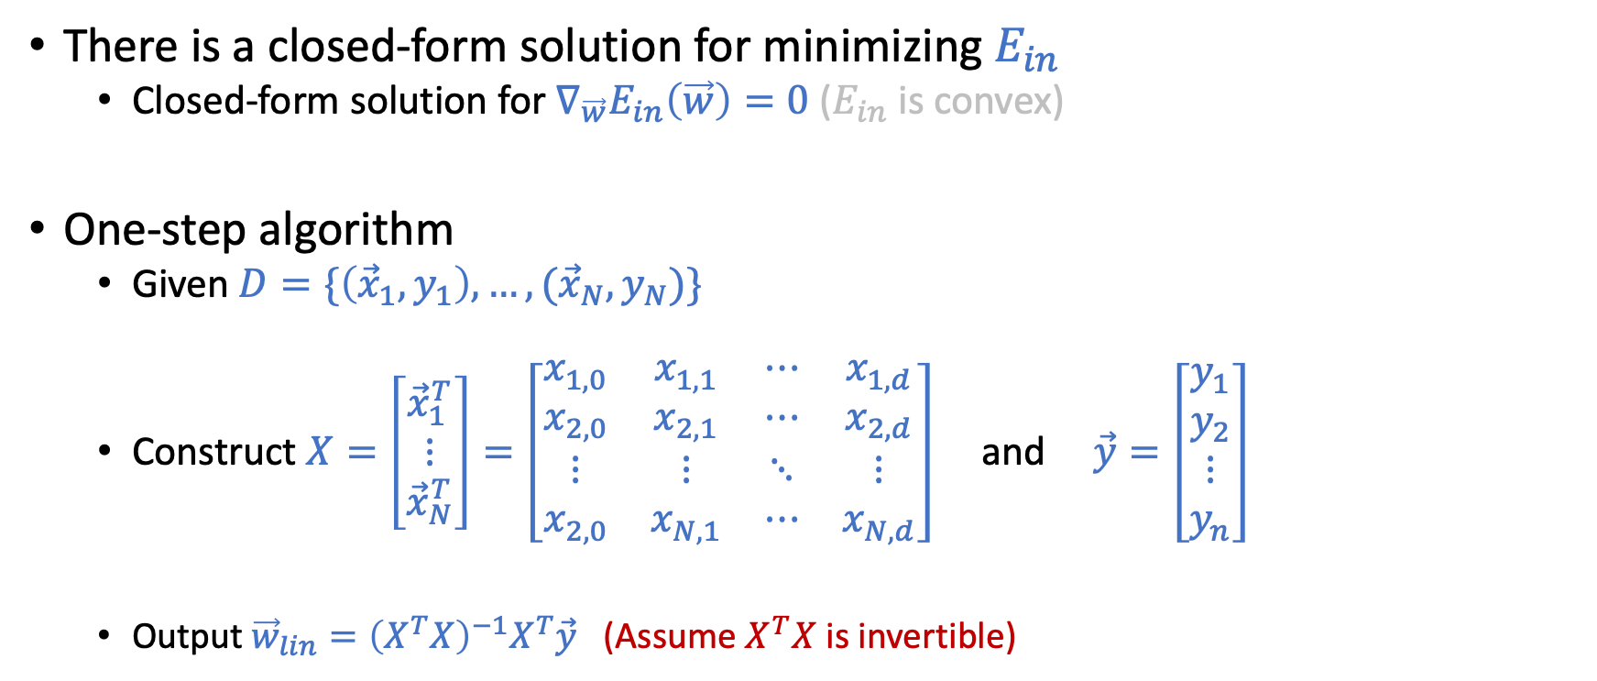
Linear Regression “Algorithm”
There is a closed-form solution for minimizing $E_{in}$
Closed-form solution for $∇_{\vec{w}}E_{in}\left(\vec{w}\right)=0$ ($E_{in}$ is convex)
One-step algorithm
Given $D=\{\left({\vec{x}}_{1},y_{1}\right),…,({\vec{x}}_{N},y_{N})\}$
Construct $X=\left[\begin{matrix}{\vec{x}}_{1}^{T} \\ ⋮ \\ {\vec{x}}_{N}^{T}\end{matrix}\right]=\left[\begin{matrix}x_{1,0} & x_{1,1} & ⋯ & x_{1,d} \\ x_{2,0} & x_{2,1} & ⋯ & x_{2,d} \\ ⋮ & ⋮ & ⋱ & ⋮ \\ x_{2,0} & x_{N,1} & ⋯ & x_{N,d}\end{matrix}\right]$ and $\vec{y}=\left[\begin{matrix}y_{1} \\ y_{2} \\ ⋮ \\ y_{n}\end{matrix}\right]$
Output ${\vec{w}}_{lin}={\left(X^{T}X\right)}^{−1}X^{T}\vec{y}$ (Assume $X^{T}X$ is invertible)

Slide 8
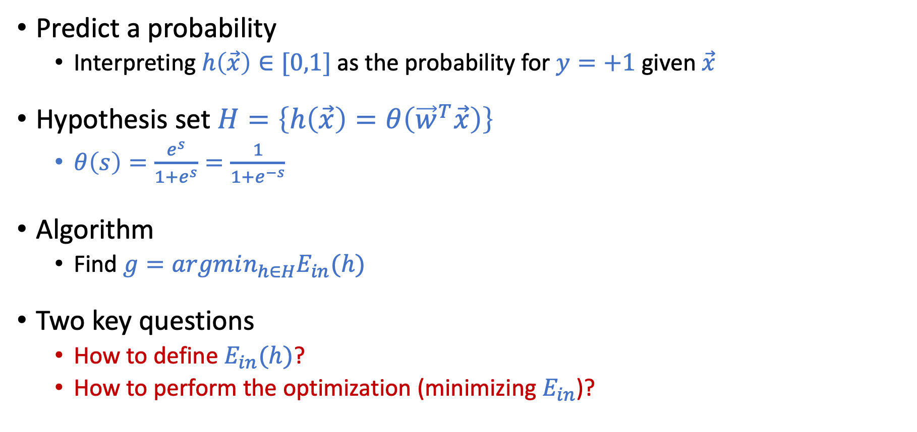
Logistic Regression
Predict a probability
Interpreting $h\left(\vec{x}\right)∈[0,1]$ as the probability for $y=+1$ given $\vec{x}$
Hypothesis set $H=\left\{h\left(\vec{x}\right)=θ\left({\vec{w}}^{T}\vec{x}\right)\right\}$
$θ\left(s\right)=\frac{e^{s}}{1+e^{s}}=\frac{1}{1+e^{−s}}$
Algorithm
Find $g=argmin_{h∈H}E_{in}(h)$
Two key questions
How to define $E_{in}(h)$?
How to perform the optimization (minimizing $E_{in}$)?

Slide 9
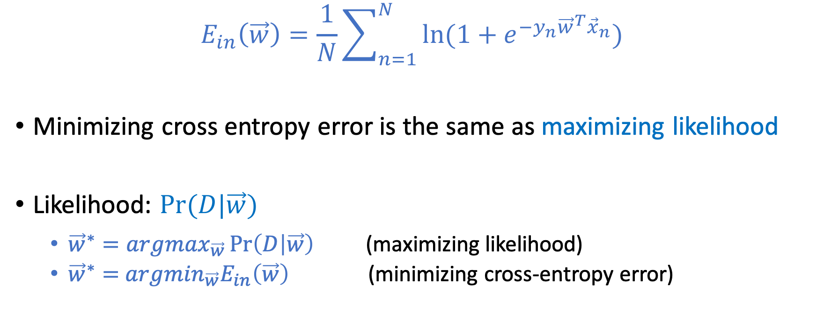
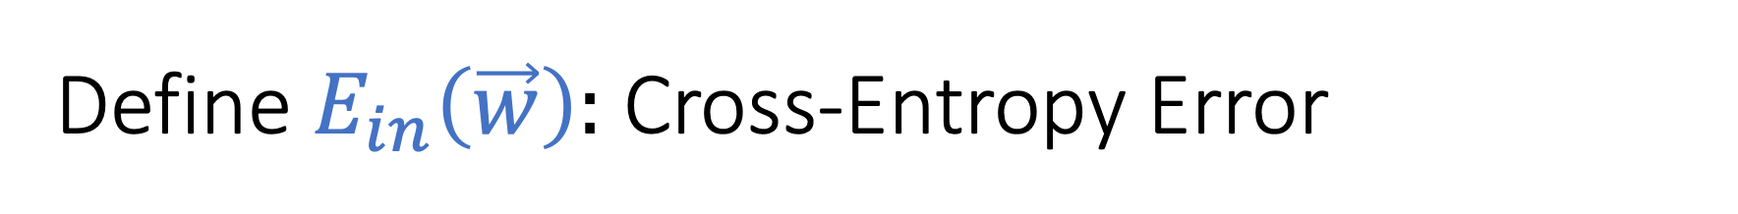
Define $E_{in}\left(\vec{w}\right):$ Cross-Entropy Error
$$E_{in}\left(\vec{w}\right)=\frac{1}{N}\sum_{n=1}^{N}{\ln{(1+e^{−y_{n}{\vec{w}}^{T}{\vec{x}}_{n}})}}$$
Minimizing cross entropy error is the same as maximizing likelihood
Likelihood: $Pr⁡(D|\vec{w})$
${\vec{w}}^{∗}=argmax_{\vec{w}}\operatorname{Pr}\left(D | \vec{w}\right)$ (maximizing likelihood)
${\vec{w}}^{∗}=$ $argmin_{\vec{w}}E_{in}\left(\vec{w}\right)$ (minimizing cross-entropy error)

Slide 10
Today’s Lecture
The notes are not intended to be comprehensive. They should be accompanied by lectures and/or textbook.
Let me know if you spot errors.

Slide 11
Minimizing Cross Entropy Error Maximizing Likelihood

Slide 12
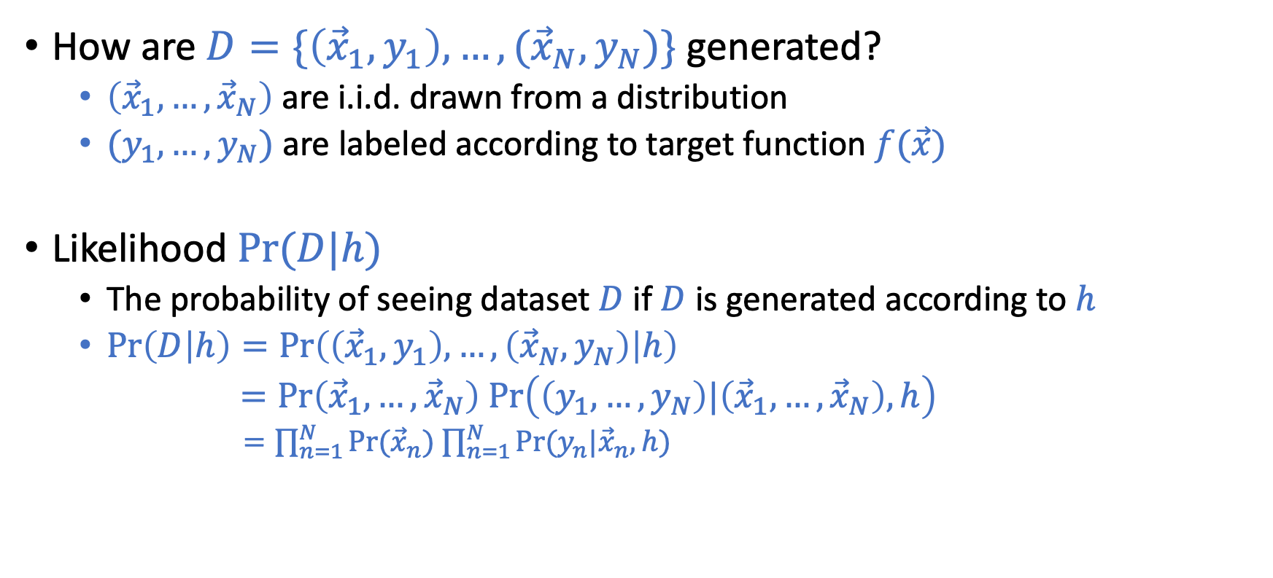
Write Down the Likelihood
How are $D=\{\left({\vec{x}}_{1},y_{1}\right),…,({\vec{x}}_{N},y_{N})\}$ generated?
$\left({\vec{x}}_{1},…,{\vec{x}}_{N}\right)$ are i.i.d. drawn from a distribution
$(y_{1},…,y_{N})$ are labeled according to target function $f(\vec{x})$
Likelihood $Pr⁡(D|h)$
The probability of seeing dataset $D$ if $D$is generated according to $h$
$\operatorname{Pr}\left(D | h\right)=\operatorname{Pr}\left(\left({\vec{x}}_{1},y_{1}\right),…,\left({\vec{x}}_{N},y_{N}\right) | h\right)$
$=Pr\left({\vec{x}}_{1},…,{\vec{x}}_{N}\right) Pr\left(\left(y_{1},…,y_{N}\right)|\left({\vec{x}}_{1},…,{\vec{x}}_{N}\right), h\right)$
$=\prod_{n=1}^{N}{Pr⁡({\vec{x}}_{n})}$ $\prod_{n=1}^{N}{Pr⁡(y_{n}|{\vec{x}}_{n}, h)}$
(Assumption of independent data)

Slide 13
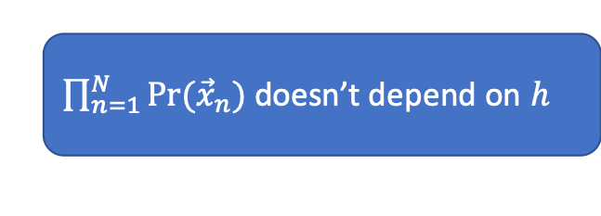
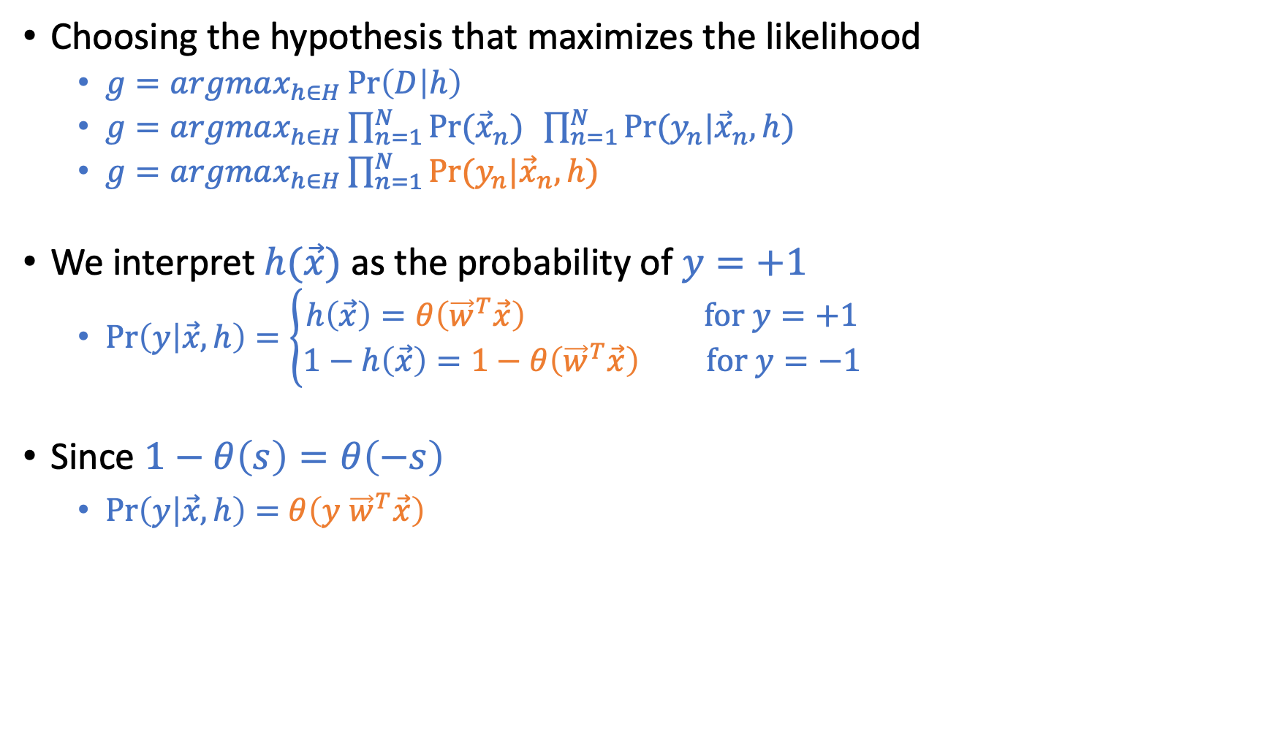
Maximum Likelihood
Choosing the hypothesis that maximizes the likelihood
$g=argmax_{h∈H}\operatorname{Pr}\left(D | h\right)$
$g=argmax_{h∈H}\prod_{n=1}^{N}{Pr⁡({\vec{x}}_{n})} \prod_{n=1}^{N}{Pr⁡(y_{n}|{\vec{x}}_{n}, h)}$
$g=argmax_{h∈H}\prod_{n=1}^{N}{Pr⁡(y_{n}|{\vec{x}}_{n}, h)}$
We interpret $h(\vec{x})$ as the probability of $y=+1$
$\operatorname{Pr}\left(y | \vec{x},h\right)=\left\{\begin{aligned}h\left(\vec{x}\right)=θ\left({\vec{w}}^{T}\vec{x}\right) \text{for} y=+1 \\ 1−h\left(\vec{x}\right)=1−θ\left({\vec{w}}^{T}\vec{x}\right) \text{for} y=−1\end{aligned}\right.$
Since $1−θ\left(s\right)=θ\left(−s\right)$
$\operatorname{Pr}\left(y | \vec{x},h\right)=$ $θ\left(y {\vec{w}}^{T}\vec{x}\right)$
$\prod_{n=1}^{N}{Pr⁡({\vec{x}}_{n})}$ doesn’t depend on $h$

Slide 14
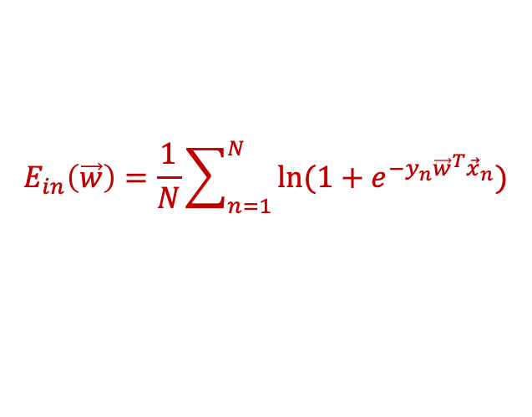
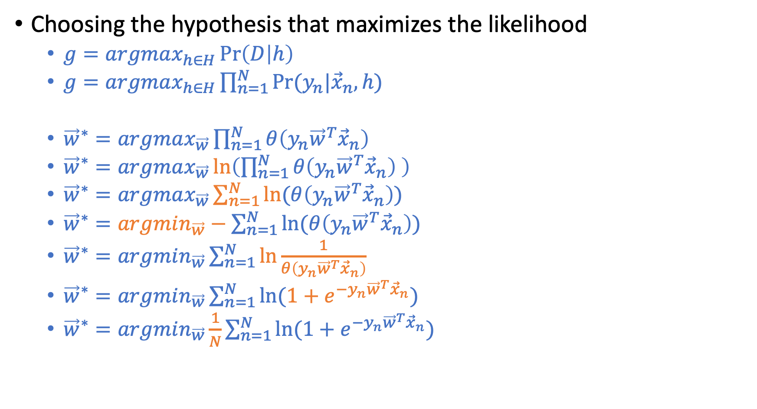
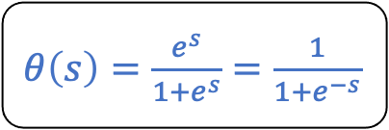
Maximum Likelihood
Choosing the hypothesis that maximizes the likelihood
$g=argmax_{h∈H}\operatorname{Pr}\left(D | h\right)$
$g=argmax_{h∈H}\prod_{n=1}^{N}{Pr⁡(y_{n}|{\vec{x}}_{n}, h)}$
${\vec{w}}^{∗}=argmax_{\vec{w}}\prod_{n=1}^{N}{θ\left(y_{n}{\vec{w}}^{T}{\vec{x}}_{n}\right) }$
${\vec{w}}^{∗}=argmax_{\vec{w}}\ln\left(\prod_{n=1}^{N}{θ\left(y_{n}{\vec{w}}^{T}{\vec{x}}_{n}\right) }\right)$
${\vec{w}}^{∗}=argmax_{\vec{w}}\sum_{n=1}^{N}{ln⁡(θ\left(y_{n}{\vec{w}}^{T}{\vec{x}}_{n}\right))}{}$
${\vec{w}}^{∗}=argmin_{\vec{w}}−\sum_{n=1}^{N}{ln⁡(θ\left(y_{n}{\vec{w}}^{T}{\vec{x}}_{n}\right))}$
${\vec{w}}^{∗}=argmin_{\vec{w}}\sum_{n=1}^{N}{ln\frac{1}{θ\left(y_{n}{\vec{w}}^{T}{\vec{x}}_{n}\right)}}$
${\vec{w}}^{∗}=argmin_{\vec{w}}\sum_{n=1}^{N}{ln(1+e^{−y_{n}{\vec{w}}^{T}{\vec{x}}_{n}})}$
${\vec{w}}^{∗}=argmin_{\vec{w}}\frac{1}{N}\sum_{n=1}^{N}{ln(1+e^{−y_{n}{\vec{w}}^{T}{\vec{x}}_{n}})}$
$θ\left(s\right)=\frac{e^{s}}{1+e^{s}}=\frac{1}{1+e^{−s}}$
$$E_{in}\left(\vec{w}\right)=\frac{1}{N}\sum_{n=1}^{N}{\ln{(1+e^{−y_{n}{\vec{w}}^{T}{\vec{x}}_{n}})}}$$

Slide 15
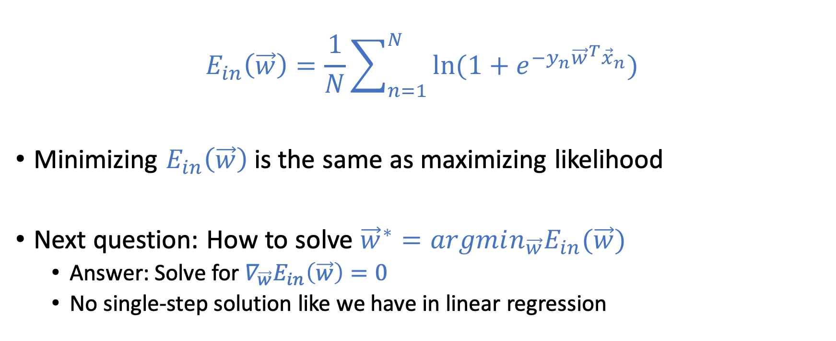
Cross Entropy Error
$$E_{in}\left(\vec{w}\right)=\frac{1}{N}\sum_{n=1}^{N}{\ln{(1+e^{−y_{n}{\vec{w}}^{T}{\vec{x}}_{n}})}}$$
Minimizing $E_{in}\left(\vec{w}\right)$ is the same as maximizing likelihood
Next question: How to solve ${\vec{w}}^{∗}=argmin_{\vec{w}}E_{in}(\vec{w})$
Answer: Solve for $∇_{\vec{w}}E_{in}\left(\vec{w}\right)=0$
No single-step solution like we have in linear regression

Slide 16
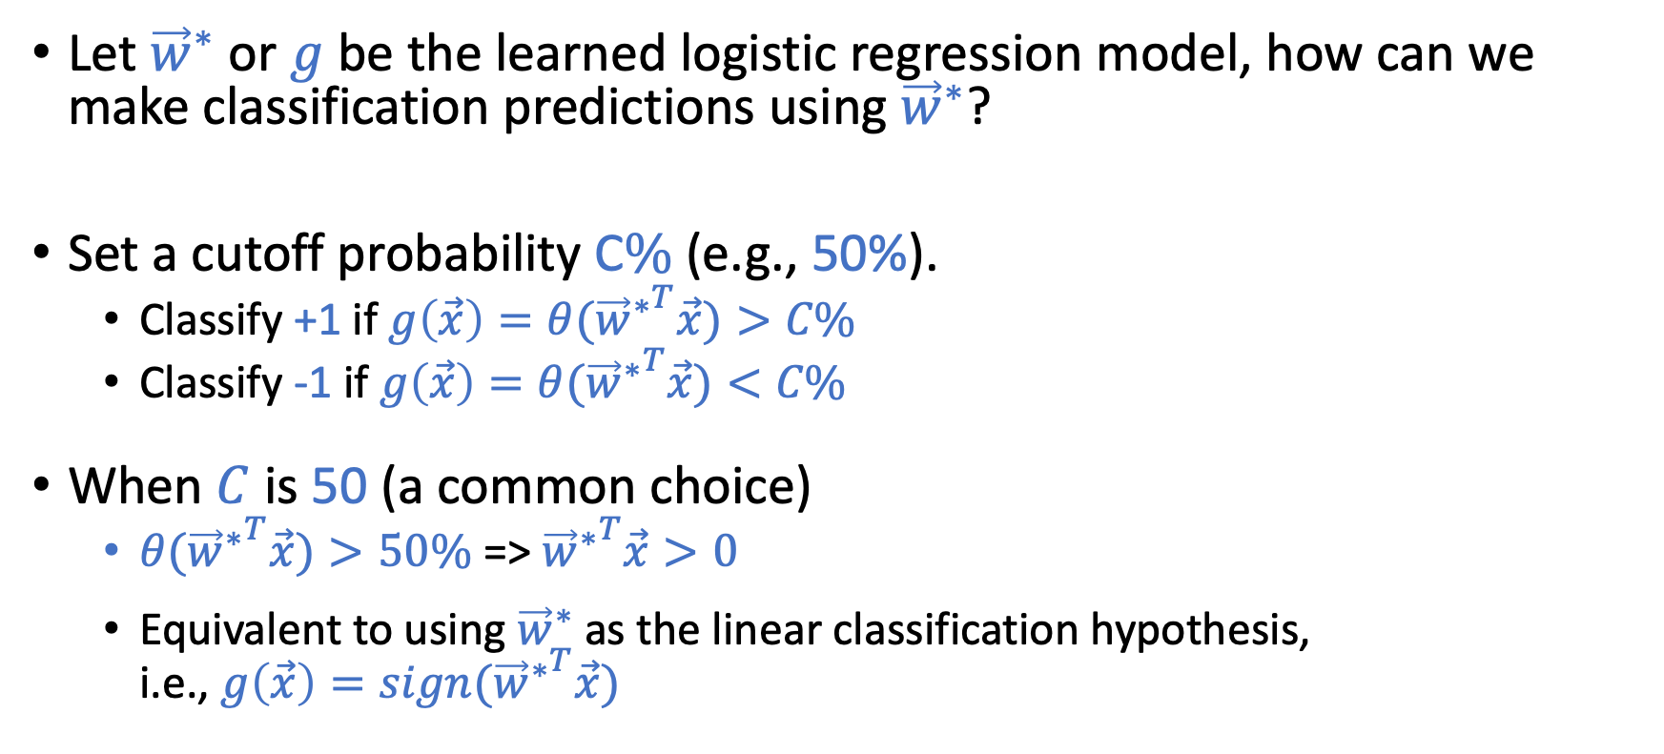
Using Logistic Regression for Classification
Let ${\vec{w}}^{∗}$ or $g$ be the learned logistic regression model, how can we make classification predictions using ${\vec{w}}^{∗}$?
Set a cutoff probability C$\%$ (e.g., 50%).
Classify +1 if $g\left(\vec{x}\right)=θ({{\vec{w}}^{∗}}^{T}\vec{x})>C\%$
Classify -1 if $g\left(\vec{x}\right)=θ({{\vec{w}}^{∗}}^{T}\vec{x})<C\%$
When $C$ is 50 (a common choice)
$θ({{\vec{w}}^{∗}}^{T}\vec{x})>50\%$ => ${{\vec{w}}^{∗}}^{T}\vec{x}>0$
Equivalent to using ${\vec{w}}^{∗}$ as the linear classification hypothesis, i.e., $g\left(\vec{x}\right)=sign({{\vec{w}}^{∗}}^{T}\vec{x})$

Slide 17
Gradient Descent
A general optimization technique

Slide 18
Gradient Descent
A technique for optimizing functions that gradients exist everywhere.
An iterative method that converges to local optimum.
Converge to global optimum if the function is convex (since there is only one local optimum).

Slide 19
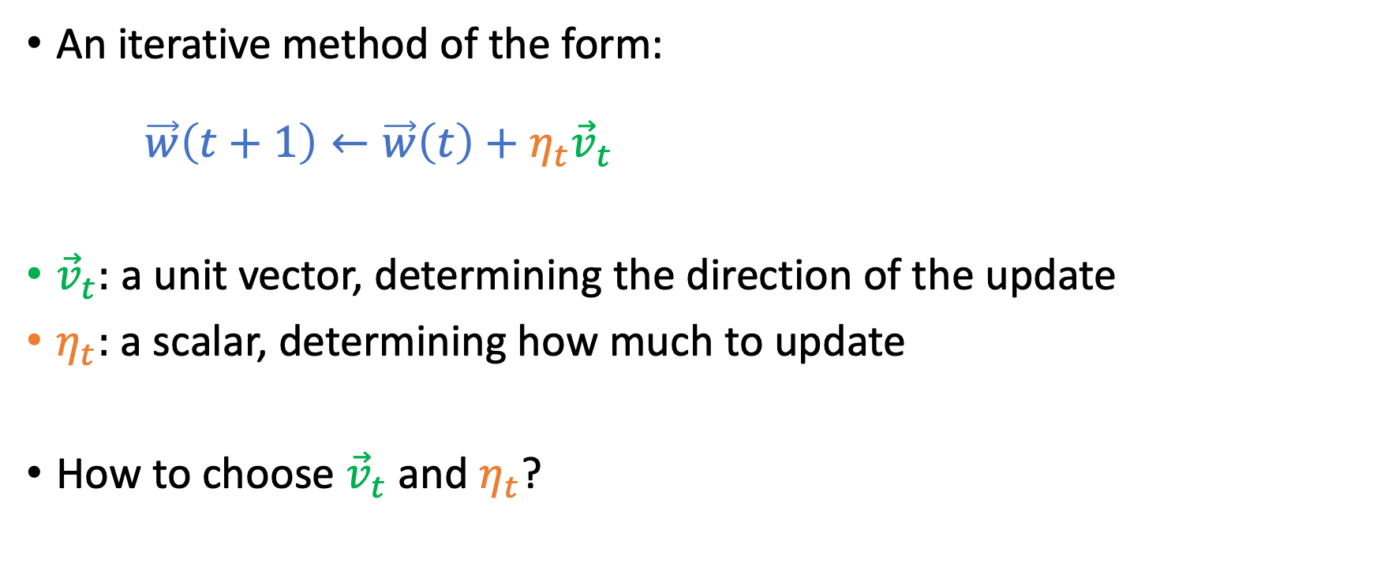

Gradient Descent: Minimizing $E_{in}(\vec{w})$
An iterative method of the form: $\vec{w}\left(t+1\right)←\vec{w}\left(t\right)+η_{t}{\vec{v}}_{t}$
${\vec{v}}_{t}:$ a unit vector, determining the direction of the update
$η_{t}:$ a scalar, determining how much to update
How to choose ${\vec{v}}_{t}$ and $η_{t}$?

Slide 20
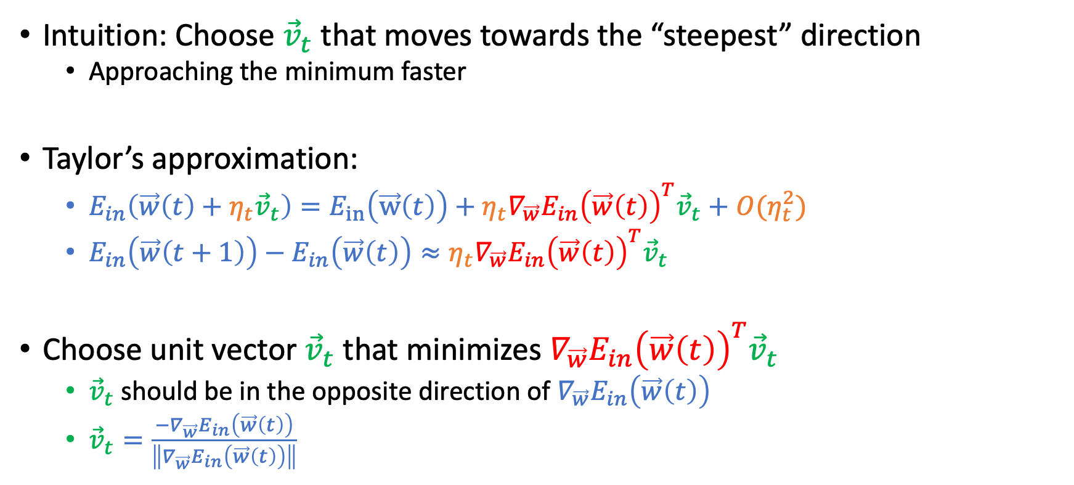


Choosing ${\vec{v}}_{t}$ in $\vec{w}\left(t+1\right)←\vec{w}\left(t\right)+η_{t}{\vec{v}}_{t}$
Intuition: Choose ${\vec{v}}_{t}$ that moves towards the “steepest” direction
Approaching the minimum faster
Taylor’s approximation:
$E_{in}\left(\vec{w}\left(t\right)+η_{t}{\vec{v}}_{t}\right)=E_{in}\left(\vec{w}\left(t\right)\right)+η_{t}∇_{\vec{w}}E_{in}{\left(\vec{w}\left(t\right)\right)}^{T}{\vec{v}}_{t}+O(η_{t}^{2})$
$E_{in}\left(\vec{w}\left(t+1\right)\right)−E_{in}\left(\vec{w}\left(t\right)\right)≈η_{t}∇_{\vec{w}}E_{in}{\left(\vec{w}\left(t\right)\right)}^{T}{\vec{v}}_{t}$
Choose unit vector ${\vec{v}}_{t}$ that minimizes $∇_{\vec{w}}E_{in}{\left(\vec{w}\left(t\right)\right)}^{T}{\vec{v}}_{t}$
${\vec{v}}_{t}$ should be in the opposite direction of $∇_{\vec{w}}E_{in}\left(\vec{w}\left(t\right)\right)$
${\vec{v}}_{t}=\frac{{−∇}_{\vec{w}}E_{in}\left(\vec{w}\left(t\right)\right)}{\left\|∇_{\vec{w}}E_{in}\left(\vec{w}\left(t\right)\right)\right\|}$
$η_{t}$ is usually small, so ignore this term

Slide 21

Choosing $η_{t}$ in $\vec{w}\left(t+1\right)←\vec{w}\left(t\right)+η_{t}{\vec{v}}_{t}$

Slide 22
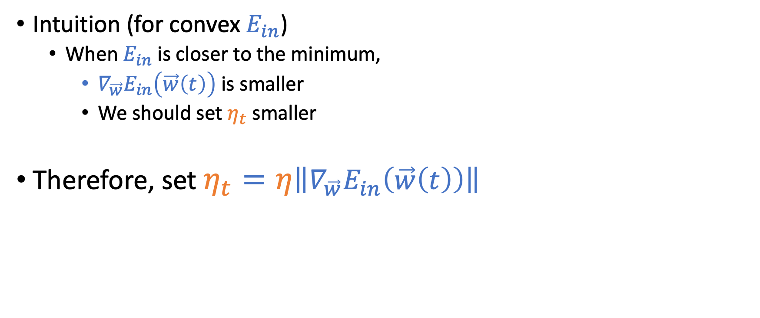
Choosing $η_{t}$ in $\vec{w}\left(t+1\right)←\vec{w}\left(t\right)+η_{t}{\vec{v}}_{t}$
Intuition (for convex $E_{in}$)
When $E_{in}$ is closer to the minimum,
$∇_{\vec{w}}E_{in}\left(\vec{w}\left(t\right)\right)$ is smaller
We should set $η_{t}$ smaller
Therefore, set $η_{t}=η\left\|∇_{\vec{w}}E_{in}\left(\vec{w}\left(t\right)\right)\right\|$

Slide 23
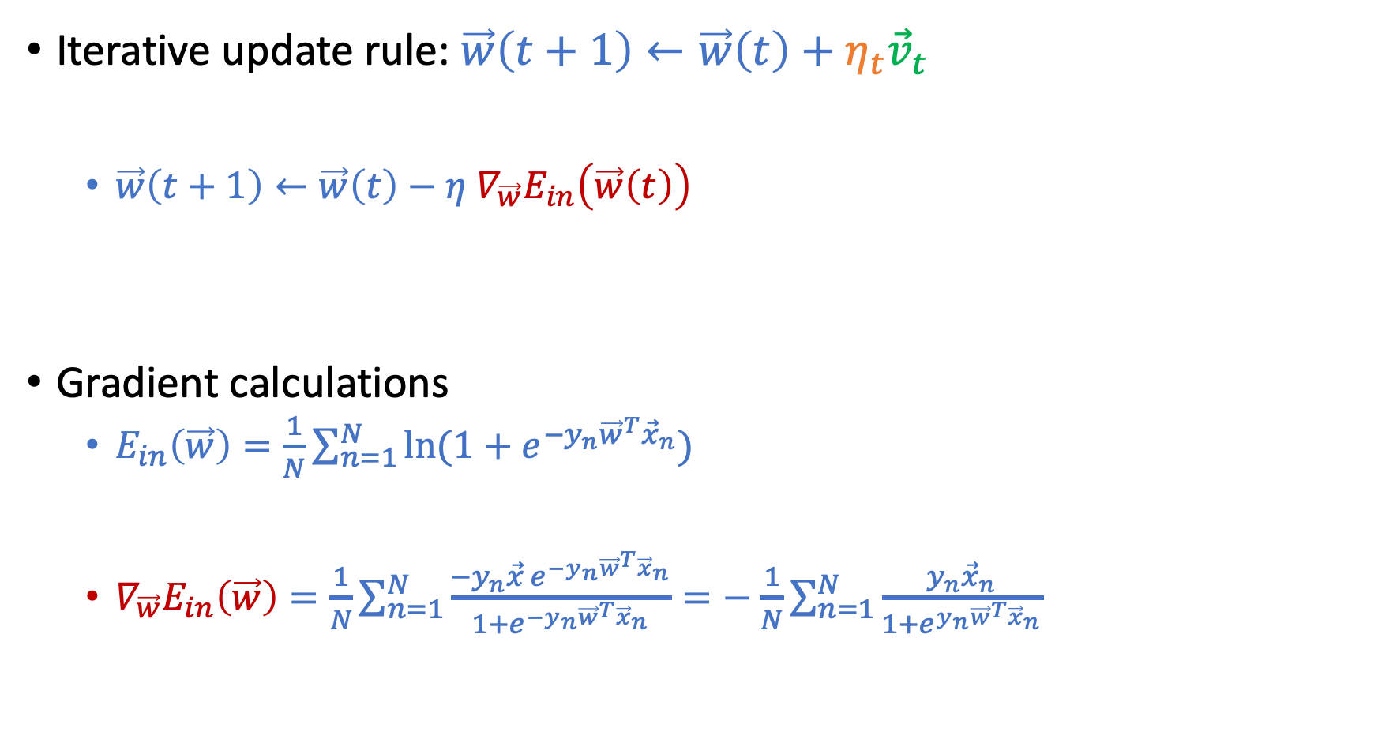
Putting Them Together
Iterative update rule: $\vec{w}\left(t+1\right)←\vec{w}\left(t\right)+η_{t}{\vec{v}}_{t}$
$\vec{w}\left(t+1\right)←\vec{w}\left(t\right)−η$ $∇_{\vec{w}}E_{in}\left(\vec{w}\left(t\right)\right)$
Gradient calculations
$E_{in}\left(\vec{w}\right)=\frac{1}{N}\sum_{n=1}^{N}{\ln{(1+e^{−y_{n}{\vec{w}}^{T}{\vec{x}}_{n}})}}$
$∇_{\vec{w}}E_{in}\left(\vec{w}\right)=\frac{1}{N}\sum_{n=1}^{N}{\frac{−y_{n}\vec{x} e^{−y_{n}{\vec{w}}^{T}{\vec{x}}_{n}}}{1+e^{−y_{n}{\vec{w}}^{T}{\vec{x}}_{n}}}}=−$ $\frac{1}{N}\sum_{n=1}^{N}{\frac{y_{n}{\vec{x}}_{n}}{1+e^{y_{n}{\vec{w}}^{T}{\vec{x}}_{n}}}}$

Slide 24
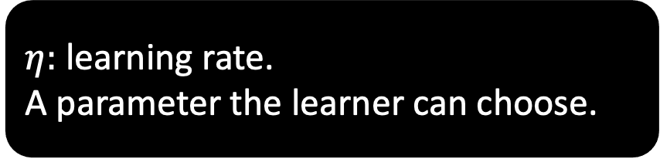
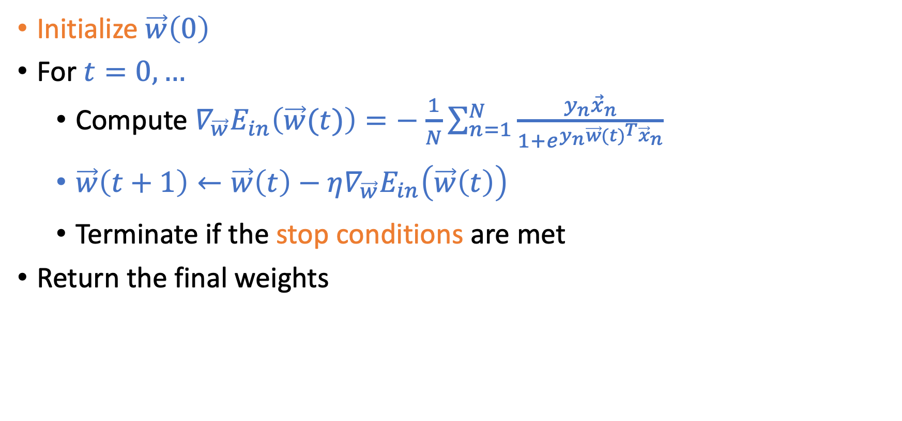
Gradient Descent for Logistic Regression
Initialize $\vec{w}\left(0\right)$
For $t=0,…$
Compute $∇_{\vec{w}}E_{in}\left(\vec{w}(t)\right)=−$ $\frac{1}{N}\sum_{n=1}^{N}{\frac{y_{n}{\vec{x}}_{n}}{1+e^{y_{n}{\vec{w}(t)}^{T}{\vec{x}}_{n}}}}$
$\vec{w}\left(t+1\right)←\vec{w}\left(t\right)−η∇_{\vec{w}}E_{in}\left(\vec{w}\left(t\right)\right)$
Terminate if the stop conditions are met
Return the final weights
$η:$ learning rate. A parameter the learner can choose.

Slide 25
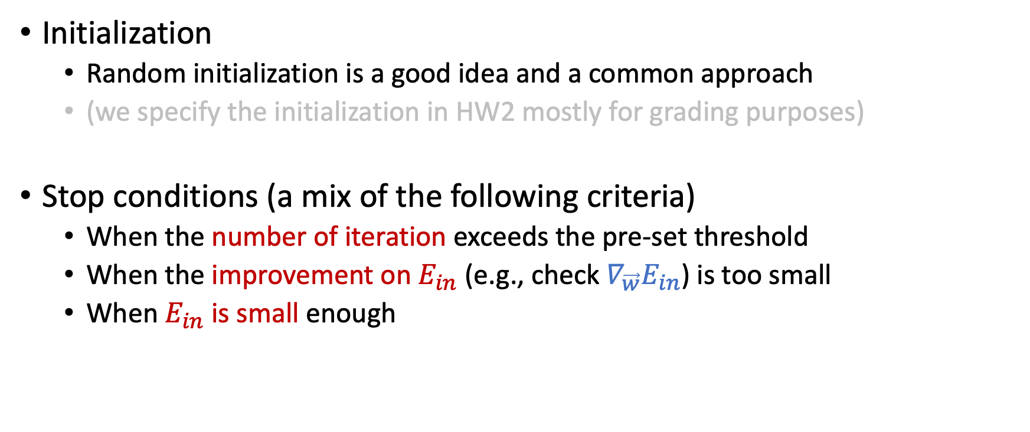
Gradient Descent for Logistic Regression
Initialization
Random initialization is a good idea and a common approach
(we specify the initialization in HW2 mostly for grading purposes)
Stop conditions (a mix of the following criteria)
When the number of iteration exceeds the pre-set threshold
When the improvement on $E_{in}$ (e.g., check $∇_{\vec{w}}E_{in}$) is too small
When $E_{in}$ is small enough

Slide 26
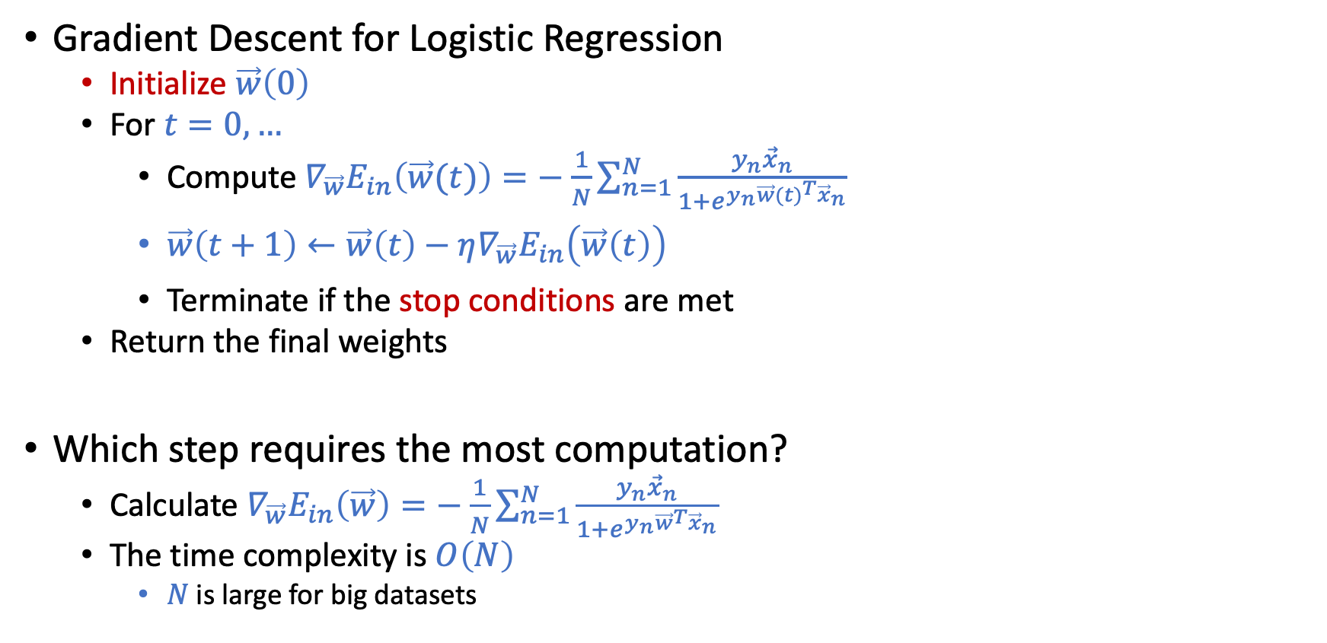
Computation of Gradient Descent
Gradient Descent for Logistic Regression
Initialize $\vec{w}\left(0\right)$
For $t=0,…$
Compute $∇_{\vec{w}}E_{in}\left(\vec{w}(t)\right)=−$ $\frac{1}{N}\sum_{n=1}^{N}{\frac{y_{n}{\vec{x}}_{n}}{1+e^{y_{n}{\vec{w}(t)}^{T}{\vec{x}}_{n}}}}$
$\vec{w}\left(t+1\right)←\vec{w}\left(t\right)−η∇_{\vec{w}}E_{in}\left(\vec{w}\left(t\right)\right)$
Terminate if the stop conditions are met
Return the final weights
Which step requires the most computation?
Calculate $∇_{\vec{w}}E_{in}\left(\vec{w}\right)=−$ $\frac{1}{N}\sum_{n=1}^{N}{\frac{y_{n}{\vec{x}}_{n}}{1+e^{y_{n}{\vec{w}}^{T}{\vec{x}}_{n}}}}$
The time complexity is $O\left(N\right)$
$N$ is large for big datasets

Slide 27
Stochastic Gradient Descent

Slide 28
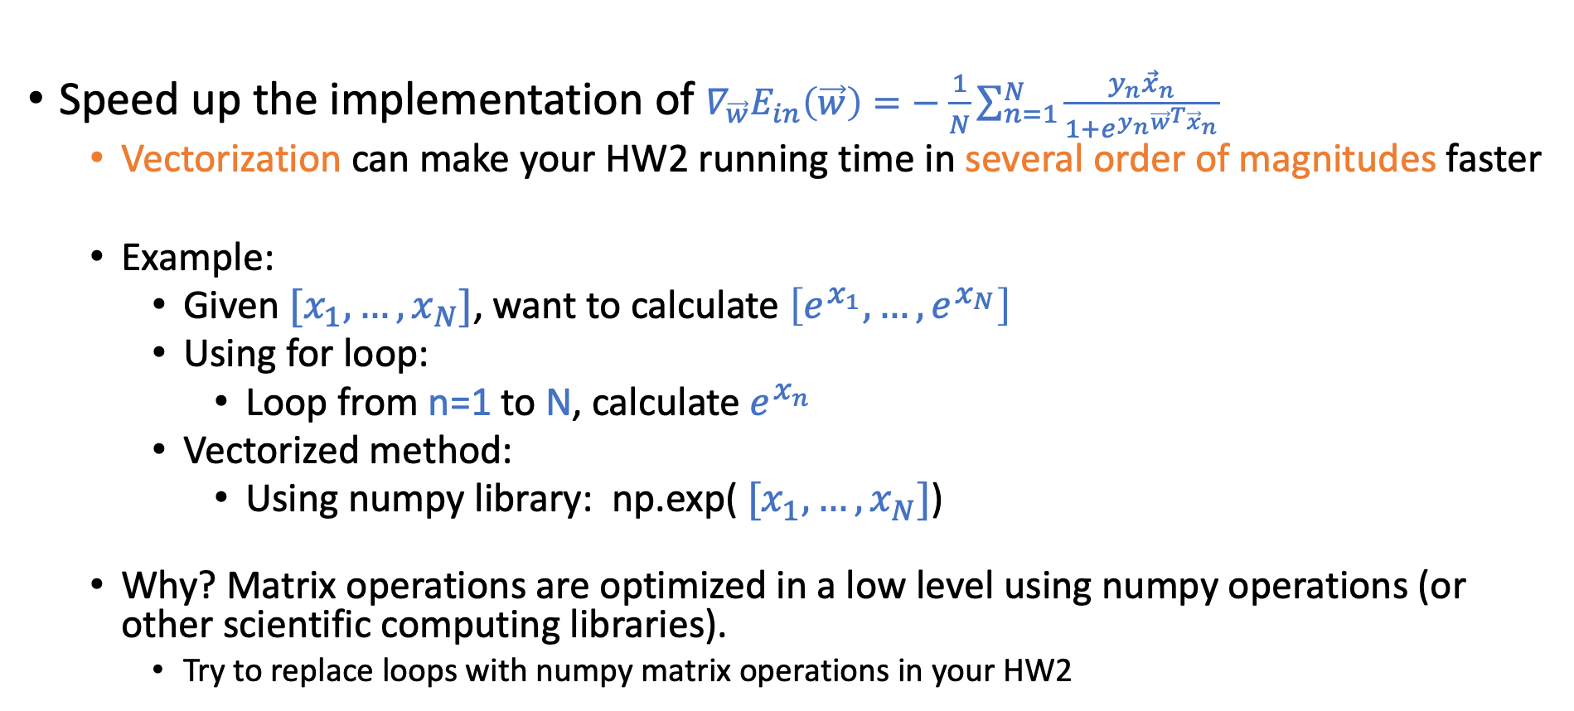

Deal with Heavy Computation of $∇_{\vec{w}}E_{in}\left(\vec{w}\right)$
Speed up the implementation of $∇_{\vec{w}}E_{in}\left(\vec{w}\right)=−$ $\frac{1}{N}\sum_{n=1}^{N}{\frac{y_{n}{\vec{x}}_{n}}{1+e^{y_{n}{\vec{w}}^{T}{\vec{x}}_{n}}}}$
Vectorization can make your HW2 running time in several order of magnitudes faster
Example:
Given${ [x}_{1},…,x_{N}]$, want to calculate $\left[e^{x_{1}},…,e^{x_{N}}\right]$
Using for loop:
Loop from n=1 to N, calculate $e^{x_{n}}$
Vectorized method:
Using numpy library: np.exp(${ [x}_{1},…,x_{N}]$)
Why? Matrix operations are optimized in a low level using numpy operations (or other scientific computing libraries).
Try to replace loops with numpy matrix operations in your HW2

Slide 29
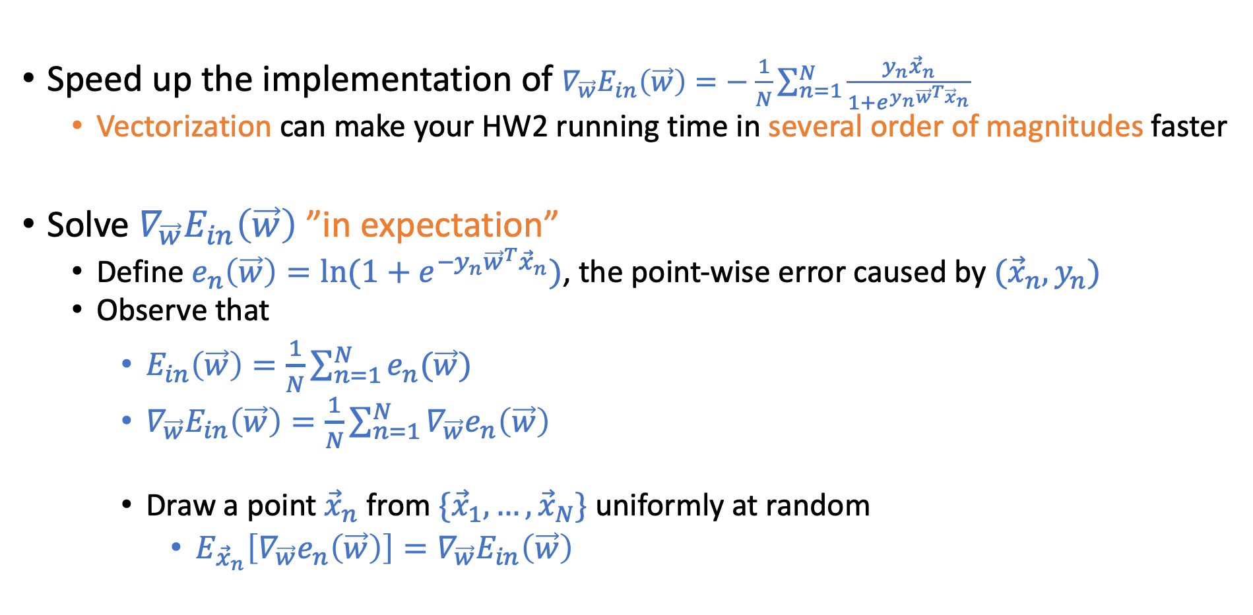
Deal with Heavy Computation of $∇_{\vec{w}}E_{in}\left(\vec{w}\right)$
Speed up the implementation of $∇_{\vec{w}}E_{in}\left(\vec{w}\right)=−$ $\frac{1}{N}\sum_{n=1}^{N}{\frac{y_{n}{\vec{x}}_{n}}{1+e^{y_{n}{\vec{w}}^{T}{\vec{x}}_{n}}}}$
Vectorization can make your HW2 running time in several order of magnitudes faster
Solve $∇_{\vec{w}}E_{in}\left(\vec{w}\right)$ ”in expectation”
Define $e_{n}\left(\vec{w}\right)=\ln{(1+e^{−y_{n}{\vec{w}}^{T}{\vec{x}}_{n}})}$, the point-wise error caused by $({\vec{x}}_{n},y_{n})$
Observe that
$E_{in}\left(\vec{w}\right)=\frac{1}{N}\sum_{n=1}^{N}{e_{n}(\vec{w})}$
$∇_{\vec{w}}E_{in}\left(\vec{w}\right)=\frac{1}{N}\sum_{n=1}^{N}{∇_{\vec{w}}e_{n}\left(\vec{w}\right)}$
Draw a point ${\vec{x}}_{n}$ from $\{{\vec{x}}_{1},…,{\vec{x}}_{N}\}$ uniformly at random
$E_{{\vec{x}}_{n}}\left[∇_{\vec{w}}e_{n}\left(\vec{w}\right)\right]=∇_{\vec{w}}E_{in}\left(\vec{w}\right)$

Slide 30
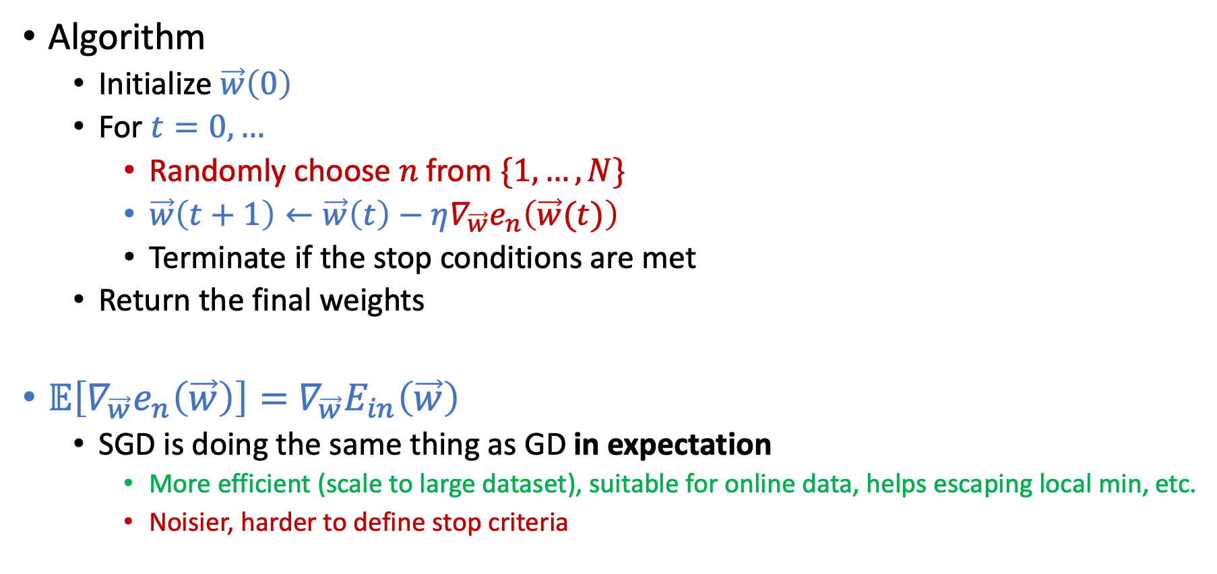
Stochastic Gradient Descent (SGD)
Algorithm
Initialize $\vec{w}\left(0\right)$
For $t=0,…$
Randomly choose $n$ from $\{1,…,N\}$
$\vec{w}\left(t+1\right)←\vec{w}\left(t\right)−η∇_{\vec{w}}e_{n}\left(\vec{w}(t)\right)$
Terminate if the stop conditions are met
Return the final weights
$𝔼\left[∇_{\vec{w}}e_{n}\left(\vec{w}\right)\right]=$ $∇_{\vec{w}}E_{in}\left(\vec{w}\right)$
SGD is doing the same thing as GD in expectation
More efficient (scale to large dataset), suitable for online data, helps escaping local min, etc.
Noisier, harder to define stop criteria

Slide 31
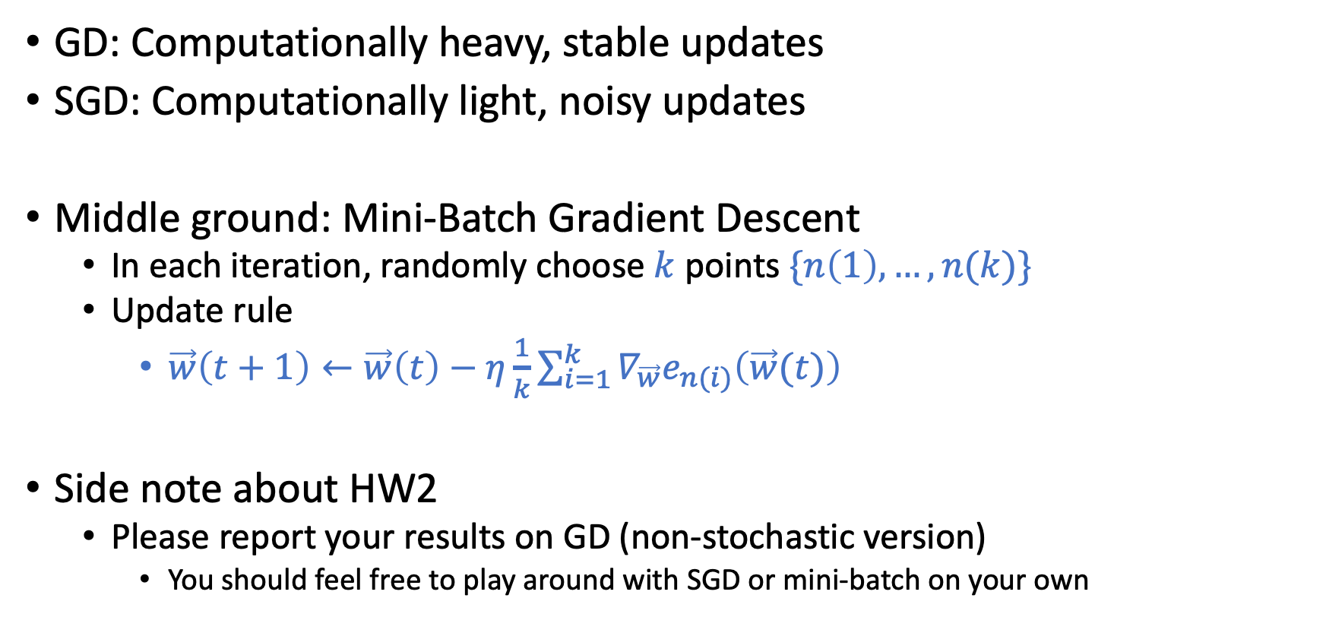
Mini-Batch Gradient Descent
GD: Computationally heavy, stable updates
SGD: Computationally light, noisy updates
Middle ground: Mini-Batch Gradient Descent
In each iteration, randomly choose $k$ points $\{n\left(1\right),…,n(k)\}$
Update rule
$\vec{w}\left(t+1\right)←\vec{w}\left(t\right)−η\frac{1}{k}\sum_{i=1}^{k}{∇_{\vec{w}}e_{n(i)}\left(\vec{w}(t)\right)}$
Side note about HW2
Please report your results on GD (non-stochastic version)
You should feel free to play around with SGD or mini-batch on your own

Slide 32
Non-Linear Transformation

Slide 33
Limitations of Linear Models

Slide 34
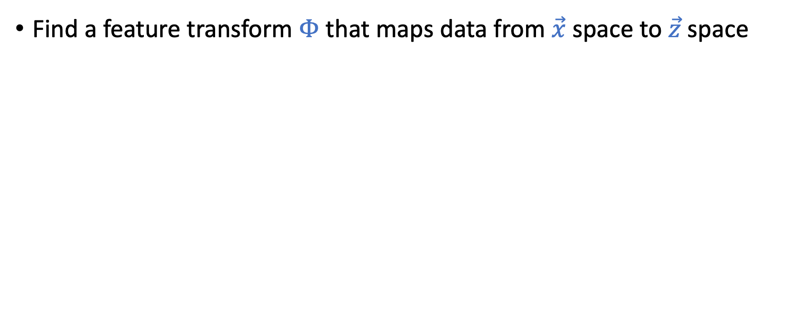
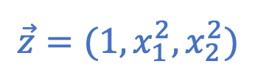
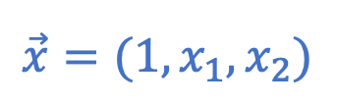
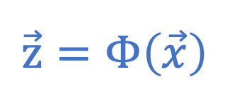
Using Non-Linear Transformations
Find a feature transform $Φ$ that maps data from $\vec{x}$ space to $\vec{z}$ space
$$\vec{z}=Φ\left(\vec{x}\right)$$
$$\vec{x}=(1,x_{1},x_{2})$$
$$\vec{z}=(1,x_{1}^{2},x_{2}^{2})$$

Slide 35
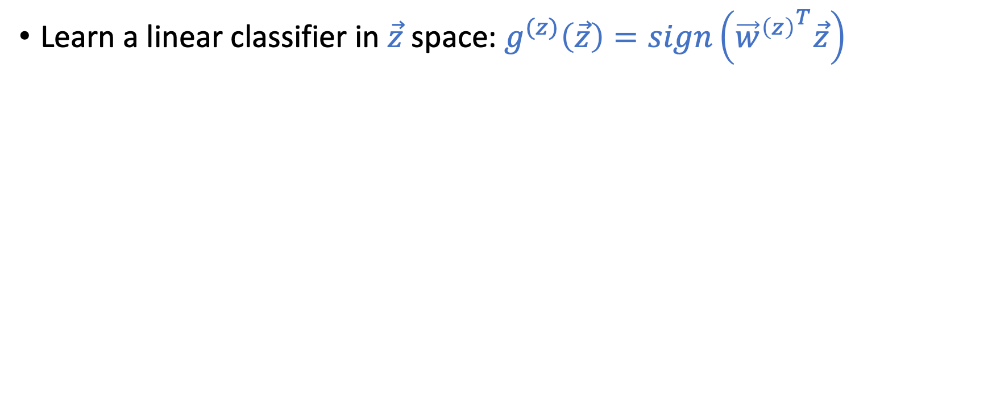
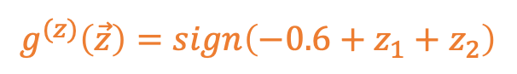
Using Non-Linear Transformations
Learn a linear classifier in $\vec{z}$ space: $g^{(z)}\left(\vec{z}\right)=sign\left({{\vec{w}}^{\left(z\right)}}^{T}\vec{z}\right)$
$$\vec{z}=Φ\left(\vec{x}\right)$$
$$\vec{x}=(1,x_{1},x_{2})$$
$$\vec{z}=(1,x_{1}^{2},x_{2}^{2})$$
$$g^{(z)}\left(\vec{z}\right)=sign\left(−0.6+z_{1}+z_{2}\right)$$

Slide 36
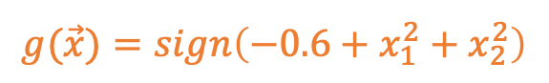
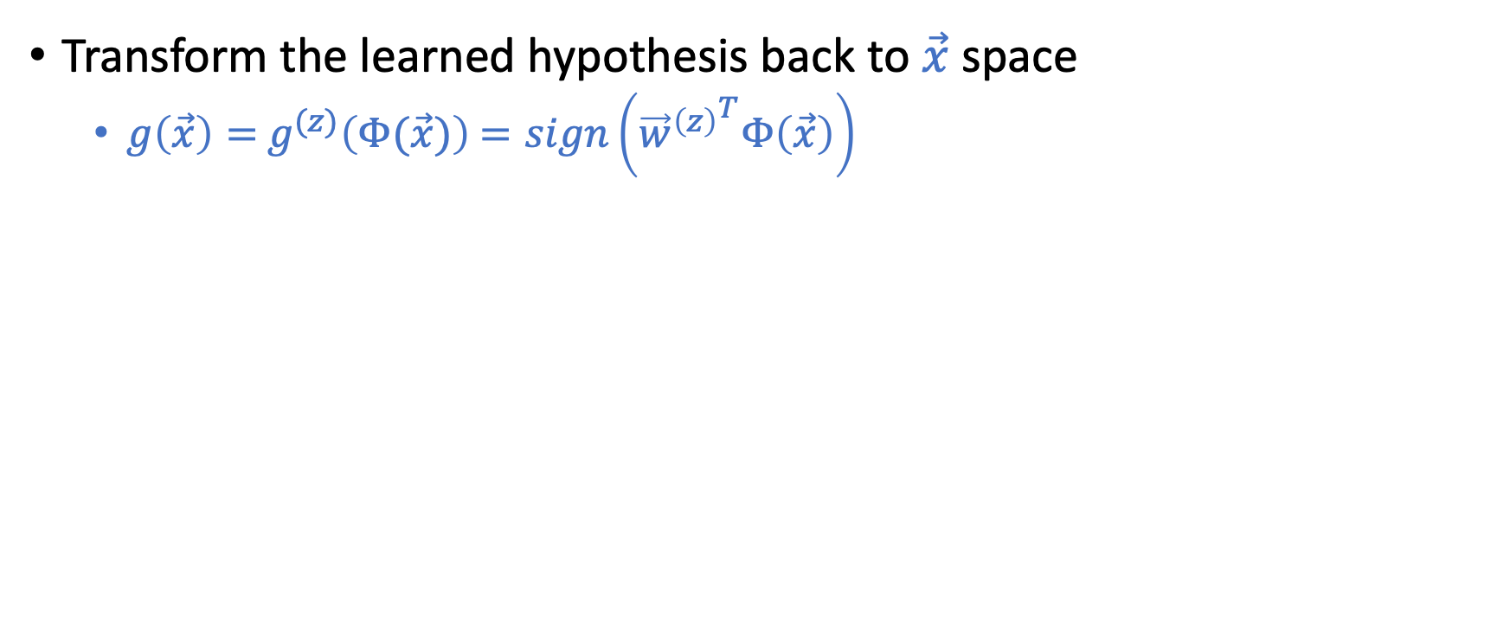
Using Non-Linear Transformations
Transform the learned hypothesis back to $\vec{x}$ space
$g\left(\vec{x}\right)=$ $g^{(z)}\left(Φ(\vec{x})\right)$ $=sign\left({{\vec{w}}^{\left(z\right)}}^{T}Φ\left(\vec{x}\right)\right)$
$$\vec{x}=(1,x_{1},x_{2})$$
$$\vec{z}=(1,x_{1}^{2},x_{2}^{2})$$
$$g(\vec{x})=sign\left(−0.6+x_{1}^{2}+x_{2}^{2}\right)$$
$$g^{(z)}\left(\vec{z}\right)=sign\left(−0.6+z_{1}+z_{2}\right)$$

Slide 37
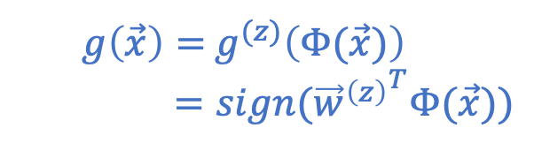
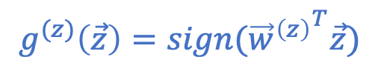
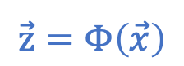
Nonlinear Transformation
$$\vec{z}=Φ\left(\vec{x}\right)$$
$$g^{(z)}\left(\vec{z}\right)=sign({{\vec{w}}^{\left(z\right)}}^{T}\vec{z})$$
$g\left(\vec{x}\right)=$ $g^{(z)}\left(Φ(\vec{x})\right)$
$=sign({{\vec{w}}^{\left(z\right)}}^{T}Φ(\vec{x}))$

Slide 38
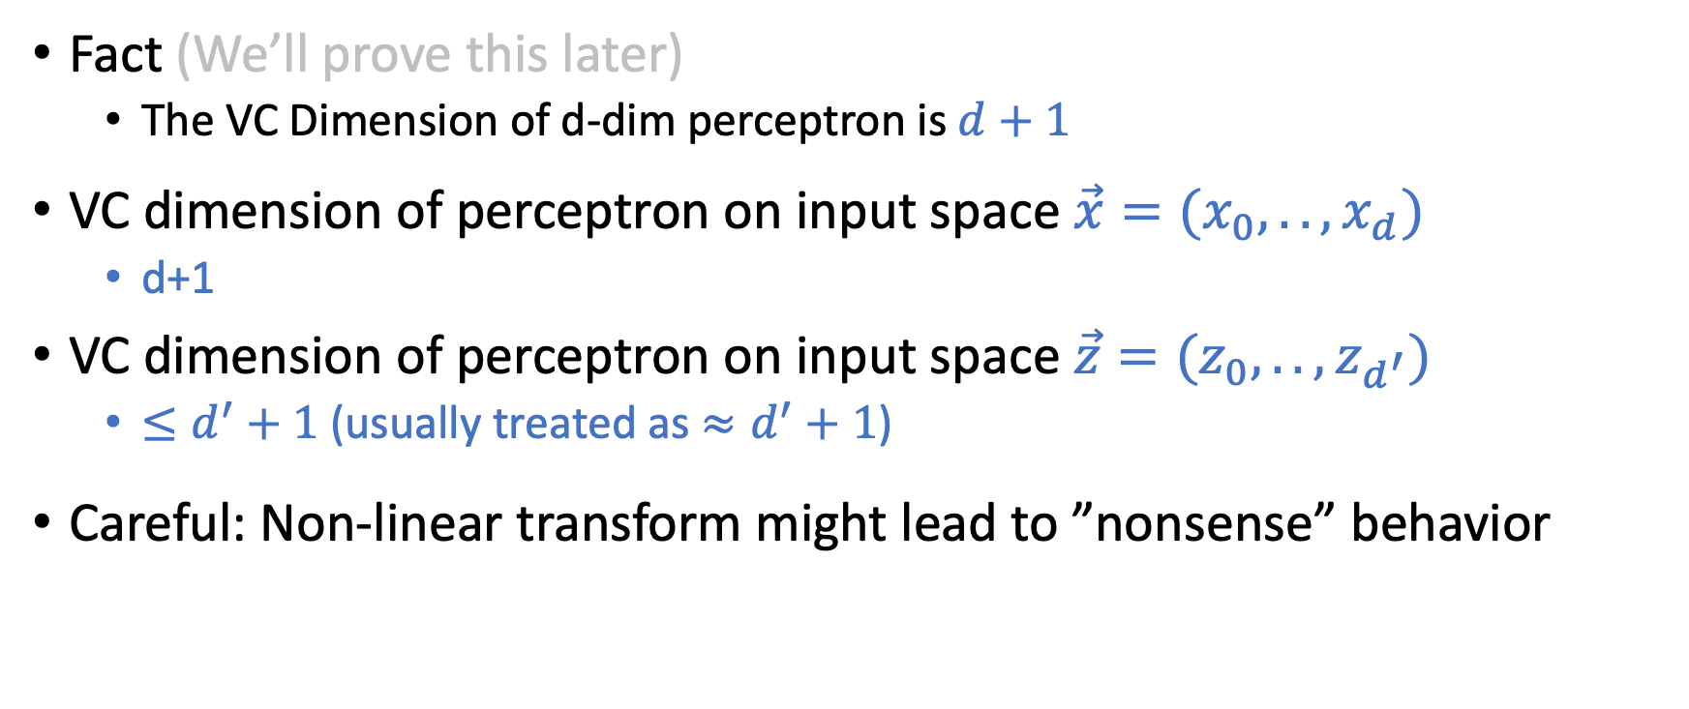
Generalization of Nonlinear Transformation
Fact (We’ll prove this later)
The VC Dimension of d-dim perceptron is $d+1$
VC dimension of perceptron on input space $\vec{x}=(x_{0},..,x_{d})$
d+1
VC dimension of perceptron on input space $\vec{z}=(z_{0},..,z_{d^{′}})$
$≤d^{′}+1$(usually treated as $≈d^{′}+1$)
Careful: Non-linear transform might lead to ”nonsense” behavior

Slide 39
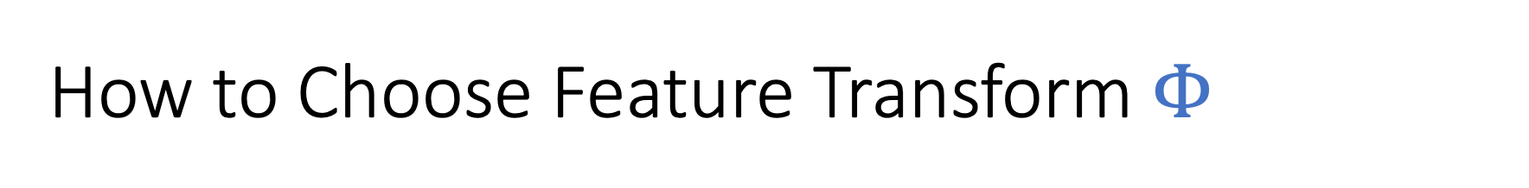
How to Choose Feature Transform $Φ$

Slide 40
How to Choose Feature Transform $Φ$
Something Seems Wrong!

Slide 41
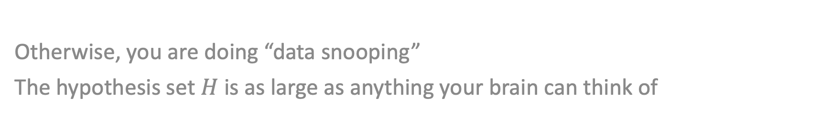

Must choose $Φ$ BEFORE looking at the data
Otherwise, you are doing “data snooping”
The hypothesis set $H$ is as large as anything your brain can think of

Slide 42
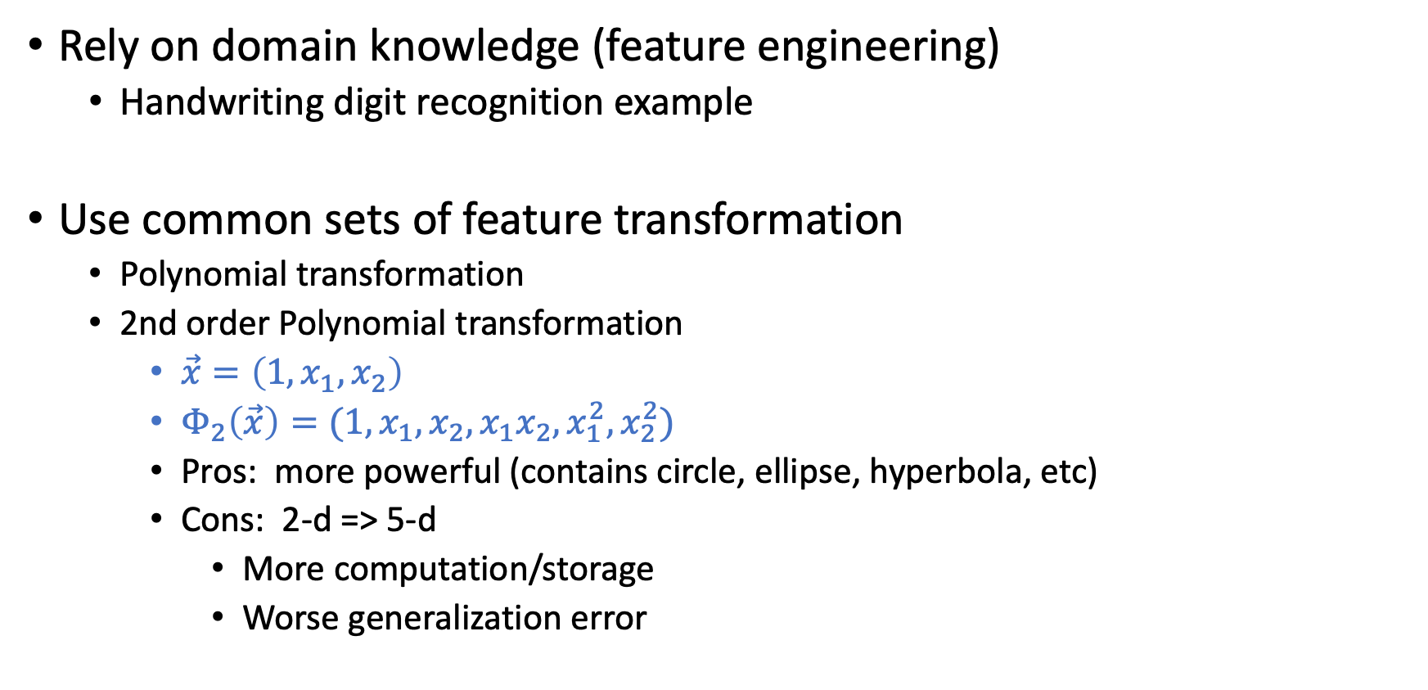

Choose $Φ$ Before Seeing Data
Rely on domain knowledge (feature engineering)
Handwriting digit recognition example
Use common sets of feature transformation
Polynomial transformation
2nd order Polynomial transformation
$\vec{x}=\left(1,x_{1},x_{2}\right)$
$Φ_{2}\left(\vec{x}\right)=(1,x_{1},x_{2},x_{1}x_{2},x_{1}^{2},x_{2}^{2})$
Pros: more powerful (contains circle, ellipse, hyperbola, etc)
Cons: 2-d => 5-d
More computation/storage
Worse generalization error
The VC dimension of d-dim perceptron is d+1

Slide 43
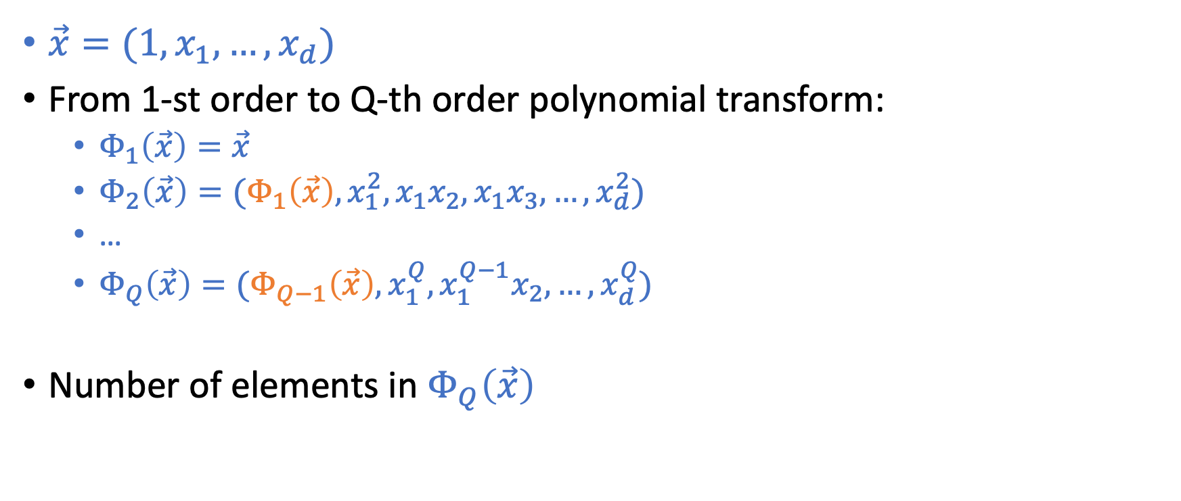
Q-th Order Polynomial Transform
$\vec{x}=(1,x_{1},…,x_{d})$
From 1-st order to Q-th order polynomial transform:
$Φ_{1}\left(\vec{x}\right)=\vec{x}$
$Φ_{2}\left(\vec{x}\right)=(Φ_{1}\left(\vec{x}\right),x_{1}^{2},x_{1}x_{2},x_{1}x_{3},…,x_{d}^{2})$
…
$Φ_{Q}\left(\vec{x}\right)=(Φ_{Q−1}\left(\vec{x}\right),x_{1}^{Q},x_{1}^{Q−1}x_{2},…,x_{d}^{Q})$
Number of elements in $Φ_{Q}\left(\vec{x}\right)$

Slide 44
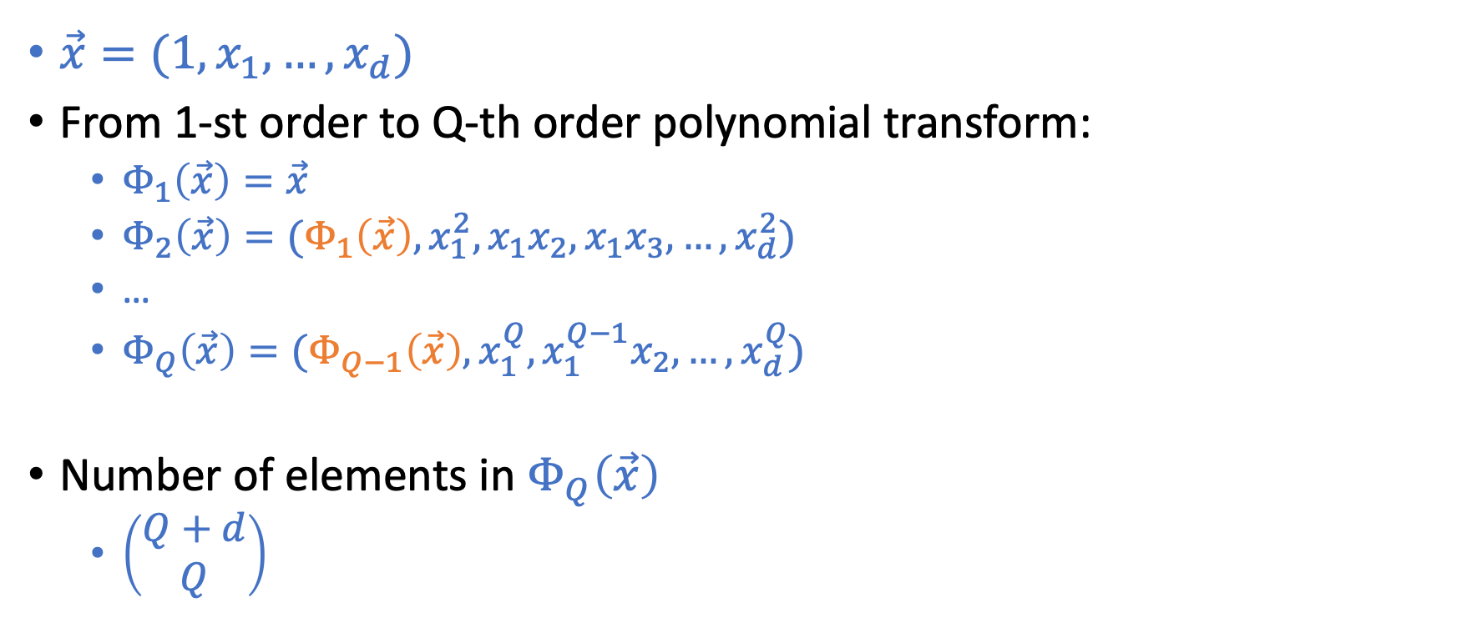
Q-th Order Polynomial Transform
$\vec{x}=(1,x_{1},…,x_{d})$
From 1-st order to Q-th order polynomial transform:
$Φ_{1}\left(\vec{x}\right)=\vec{x}$
$Φ_{2}\left(\vec{x}\right)=(Φ_{1}\left(\vec{x}\right),x_{1}^{2},x_{1}x_{2},x_{1}x_{3},…,x_{d}^{2})$
…
$Φ_{Q}\left(\vec{x}\right)=(Φ_{Q−1}\left(\vec{x}\right),x_{1}^{Q},x_{1}^{Q−1}x_{2},…,x_{d}^{Q})$
Number of elements in $Φ_{Q}\left(\vec{x}\right)$
$\left(\begin{matrix}Q+d \\ Q\end{matrix}\right)$

Slide 45
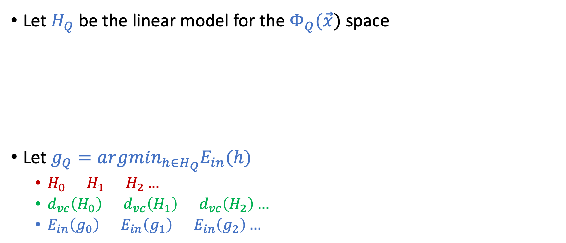
Structural Hypothesis Sets
Let $H_{Q}$ be the linear model for the $Φ_{Q}(\vec{x})$ space
Let $g_{Q}=argmin_{h∈H_{Q}}E_{in}(h)$
$H_{0}⊂H_{1}⊂H_{2}…$
$d_{vc}\left(H_{0}\right)≤d_{vc}\left(H_{1}\right)≤d_{vc}\left(H_{2}\right)…$
$E_{in}\left(g_{0}\right)≥E_{in}\left(g_{1}\right)≥E_{in}\left(g_{2}\right)…$

Slide 46
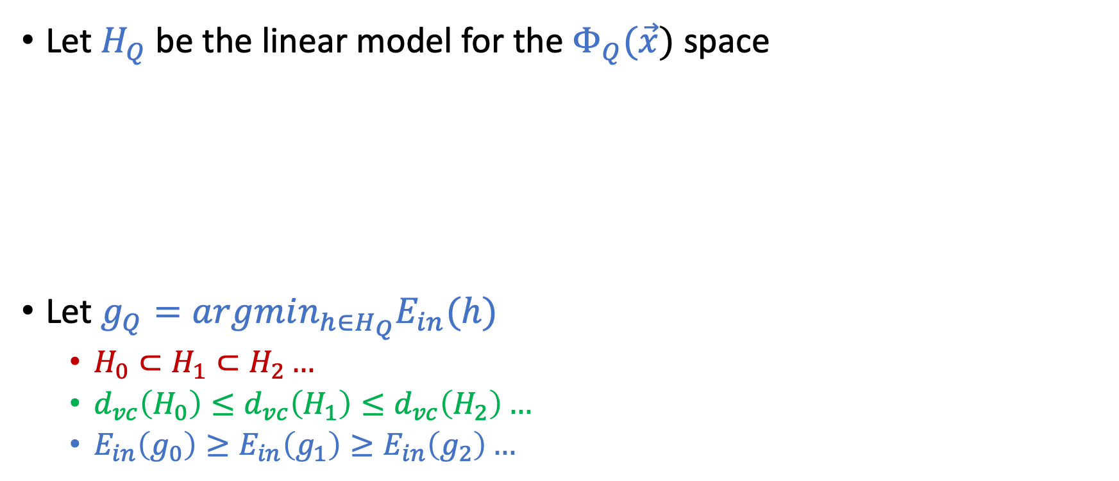
Structural Hypothesis Sets
Let $H_{Q}$ be the linear model for the $Φ_{Q}(\vec{x})$ space
Let $g_{Q}=argmin_{h∈H_{Q}}E_{in}(h)$
$H_{0}⊂H_{1}⊂H_{2}…$
$d_{vc}\left(H_{0}\right)≤d_{vc}\left(H_{1}\right)≤d_{vc}\left(H_{2}\right)…$
$E_{in}\left(g_{0}\right)≥E_{in}\left(g_{1}\right)≥E_{in}\left(g_{2}\right)…$

